Slide 1





Temporal Performance Modeling of Serverless Computing Platforms
Nima Mahmoudi
Hamzeh Khazaei
nmahmoud@ualberta.ca
hkh@yorku.ca
N. Mahmoudi and H. Khazaei, “Temporal Performance Modelling of Serverless Computing Platforms,” in Proceedings of the 6th International Workshop on Serverless Computing, 2020, p. 1–6., doi: 10.10.1145/3429880.3430092.
Performant and Available
Computing Systems (PACS) Lab

Slide 2
TOC
Introduction
System Description
Analytical Modelling
Experimental Validation
Conclusion

Slide 3
Introduction

Slide 4
Serverless Computing
Runtime operation and management done by the provider
Reduces the overhead for the software owner
Provisioning
Scaling resources
Software is developed by writing functions
Well-defined interface
Functions deployed separately

Slide 5
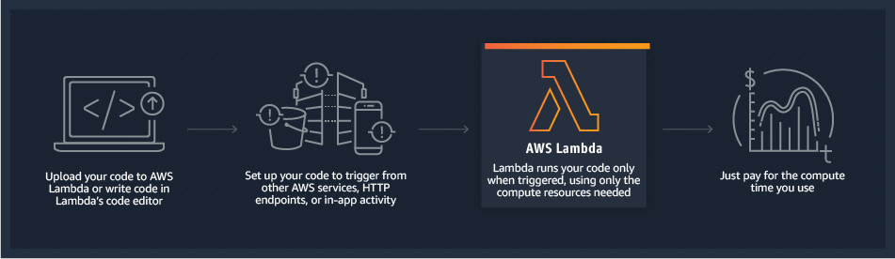
Serverless Computing
Image source: https://aws.amazon.com/lambda/

Slide 6
The Need for a Performance Model
No previous work has been done for performance modelling of Serverless Computing platforms
Accurate performance modelling can beneficial in many ways:
Ensure the Quality of Service (QoS)
Improve performance metrics
Predict/optimize infrastructure cost
Move from best-effort to performance guarantees
It can benefit both serverless provider and application developer

Slide 7
System Description

Slide 8
Function States, Cold Starts, and Warm Starts
Function States:
Initializing: Performing initialization tasks to prepare the function for incoming requests. Includes infrastructure initialization and application initialization.
Running: Running the tasks required to process a request.
Idle: Provisioned instance that is not running any workloads. The instances in this state are not billed.
Cold Start Requests:
A request that needs to go through initialization steps due to lack of provisioned capacity.
Warm Start Requests:
Only includes request processing time since idle instance was available

Slide 9
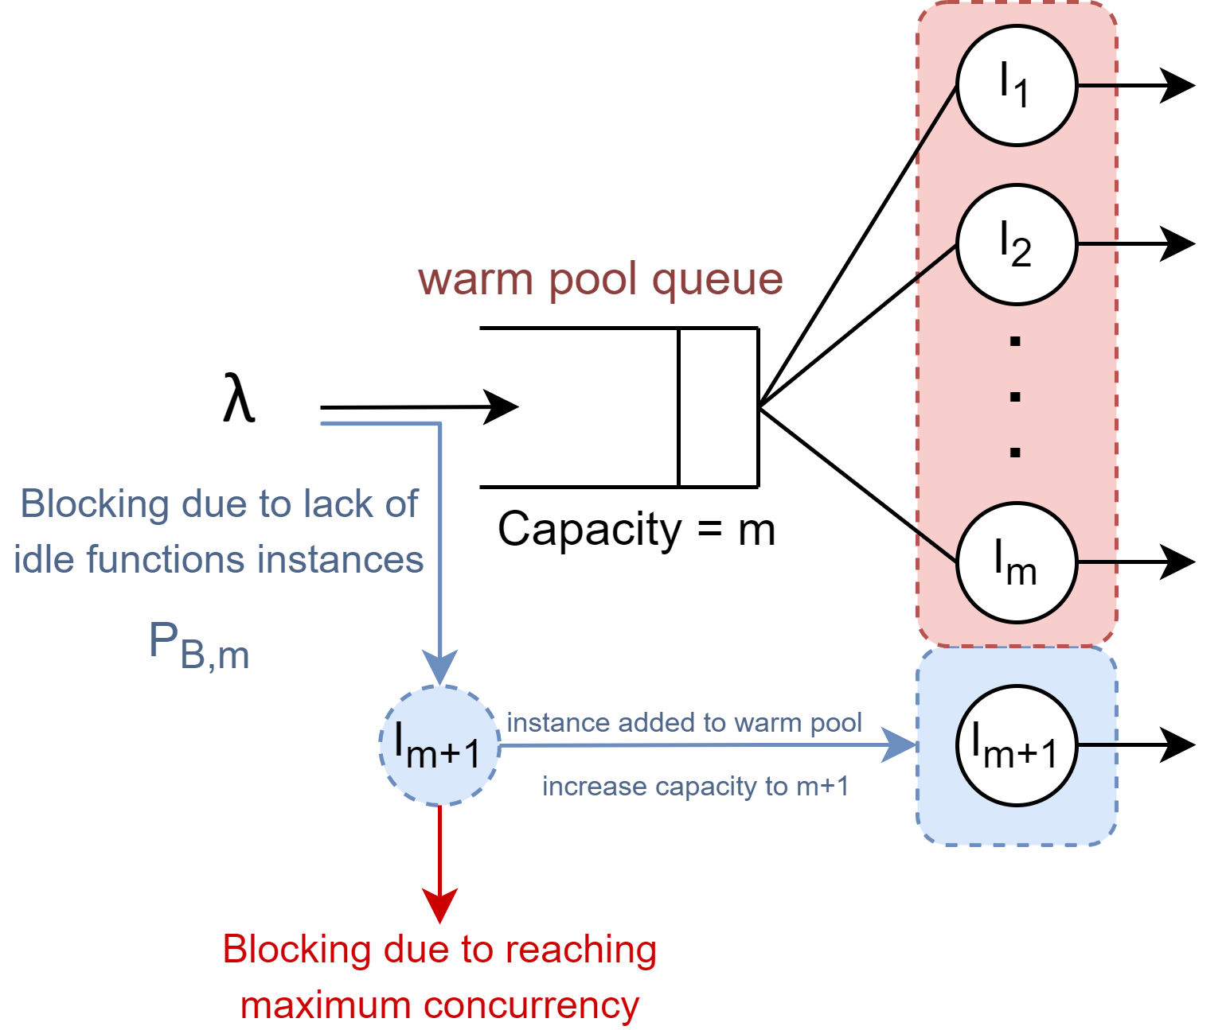
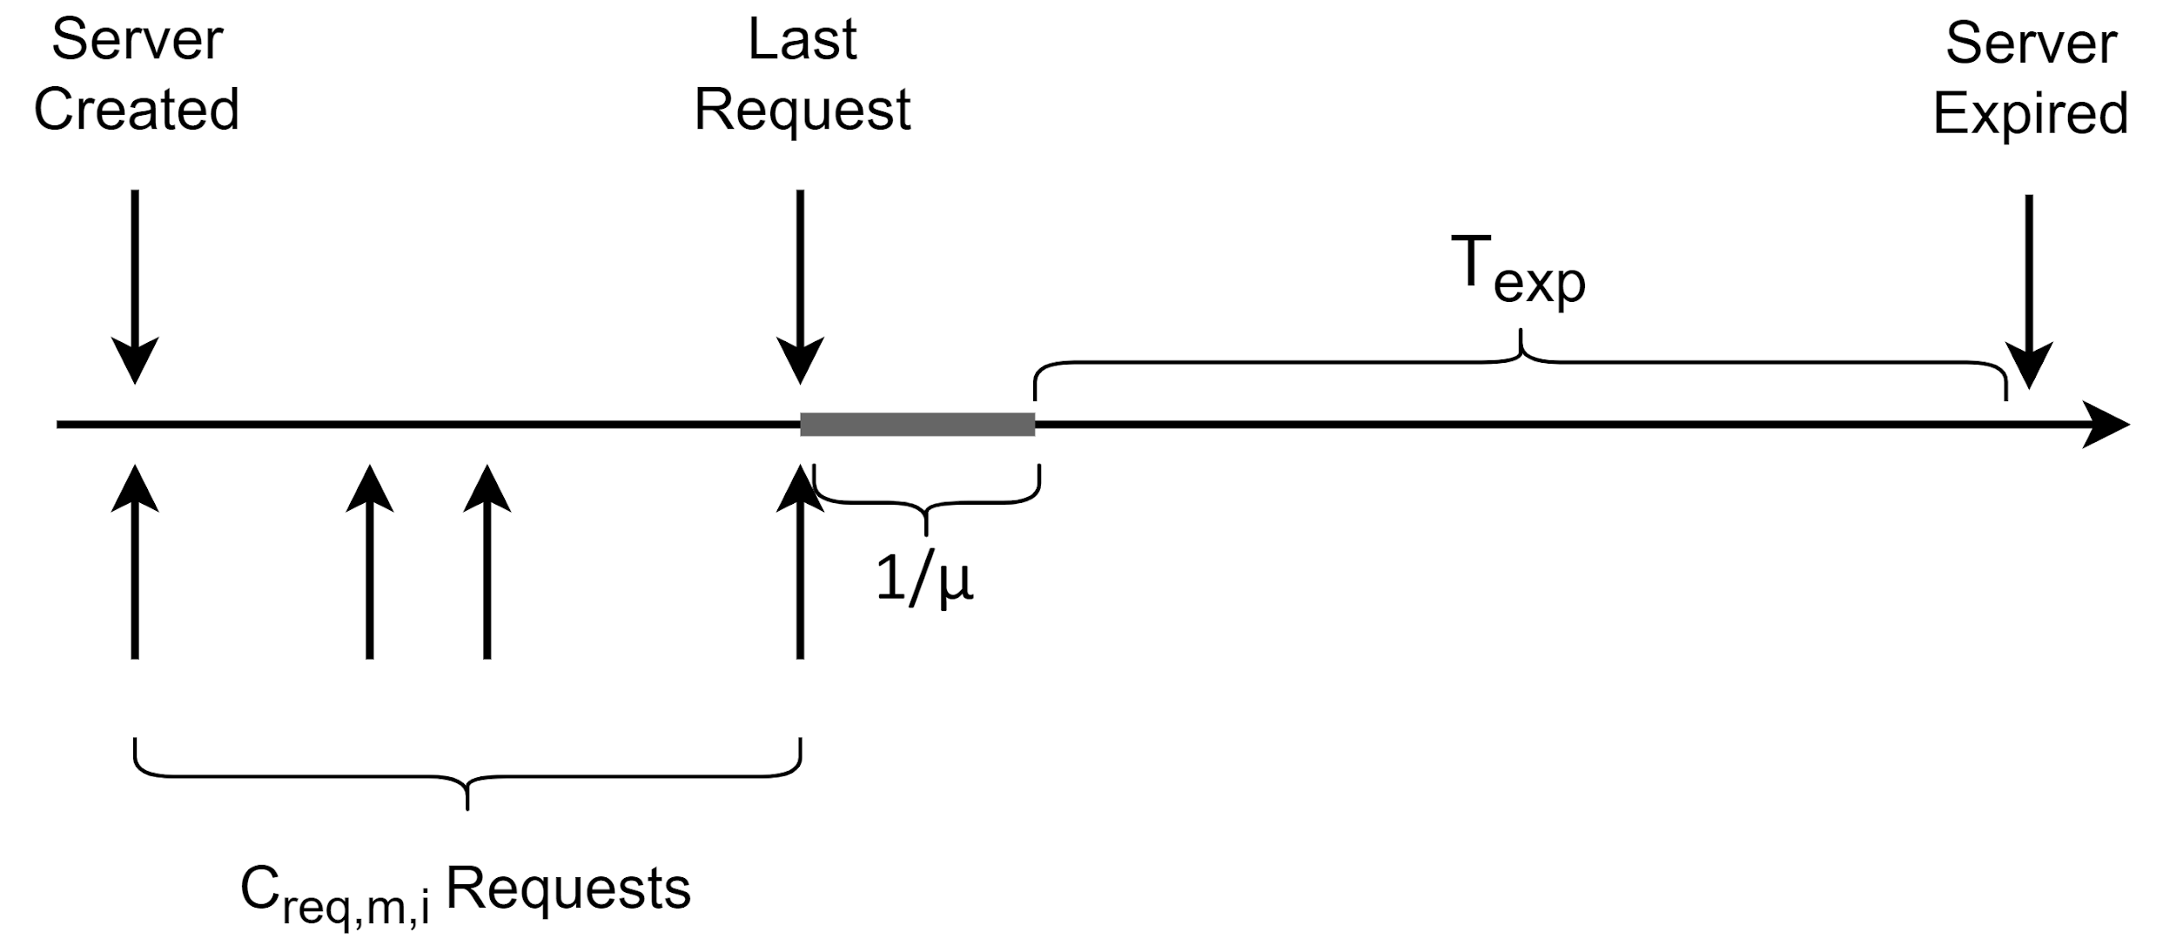
Autoscaling
Scaling Out:
Expiration Threshold
Scaling In:
Notes:
Autoscaling consists of two actions: scaling out and scaling in

Slide 10
Other Important Characteristics
Initialization Time: The amount of time instance spends in the initializing state.
Response Time: No queuing, so it is equal to service time. It remains stable throughout time for cold and warm start requests.
Maximum Concurrency Level: Maximum number of instances that can be in the state running in parallel.
Request Routing: To facilitate scaling in, requests are routed to recently created instances first.

Slide 11
Analytical Modelling

Slide 12
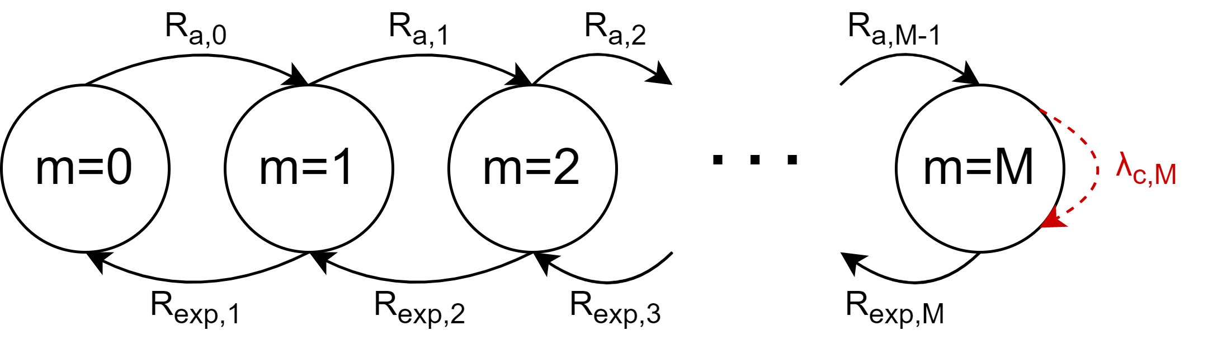
Overview
Warm Pool Model:
Notes:
The warm pool is modelled using a Markov chain where each state represents the number of instances in the pool
The rate of adding servers can be calculated from warm queue modelled by M/G/m/m
The rate of expiring instances is calculated from analyzing their lifecycle and calculating average number of requests received before expiration happens

Slide 13
Cold Start Rate
The system behaves like an Erlang Loss System (M/G/m/m).
The blocked requests are either rejected (reached maximum concurrency level) or cause a cold start (and thus the creation of a new instance)
Arrival Rate for Each Instance
Requests blocked by instance n are either processed by instance n+1 or blocked by it.
The difference between blocked rates gives us individual arrival rates.
Server Expiration Rate
Can be calculated knowing individual arrival rates and expiration threshold.
Warm Pool Model
Each state represents the number of instances in the warm pool.

Slide 14
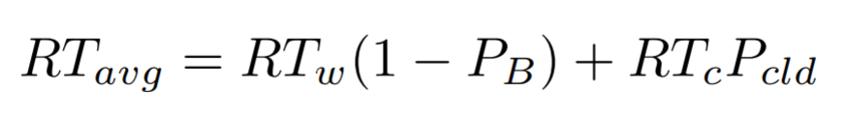
For each state, we can also calculate:
Probability of Rejection: Probability of being blocked when reaching maximum concurrency.
Probability of Cold Start: Probability of being blocked in other states.
Average Response Time:
Mean Number of Instances in Warm Pool:
Running
Idle
Utilization: Ratio of instances in running state over all instances.
All predictions can be found in a time-bounded fashion (e.g., answers the question “what happens to my QoS in the next 5 minutes?”)

Slide 15
Experimental Validation

Slide 16
Experimental Setup
Experiments done on AWS Lambda
Python 3.6 runtime with 128MB of RAM on us-east-1 region
A mixture of CPU and IO intensive tasks
Client was a virtual machine on Compute Canada Arbutus
8 vCPUs, 16GB of RAM, 1000Mbps connectivity, single-digit milliseconds latency to AWS servers
Python with in-house workload generation tool pacswg
Official boto3 library for API communication
Communicated directly with Lambda API, no intermediary interfaces like API Gateway
Predictions are made 5 minutes into the future
Assumed oracle request pattern prediction

Slide 17
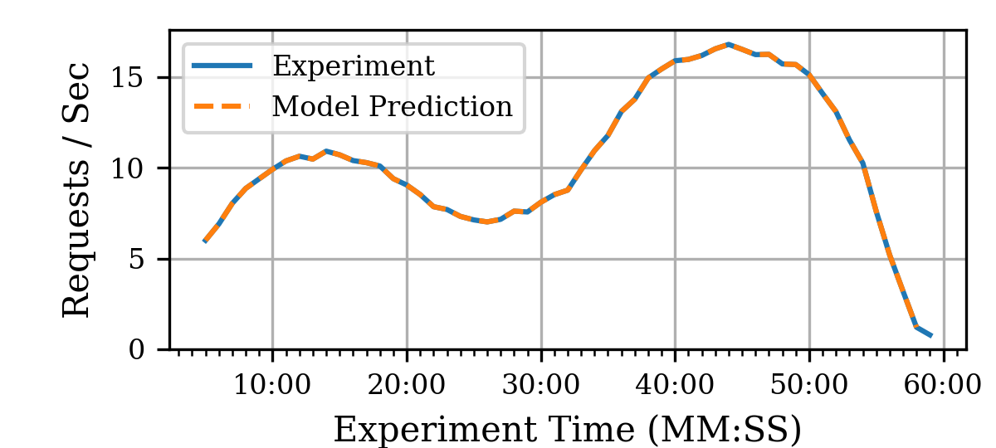
Sample Workload
Notes:
We analyzed a range of different workloads to show how their characteristics differ under different configurations of expiration threshold
References can be found in the paper

Slide 18
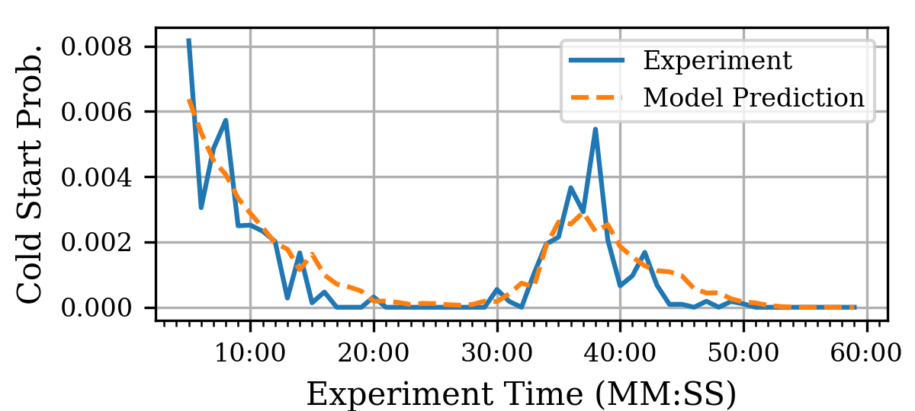
Experimental Results
Notes:
Bars show standard error
Each point is the average of 28 hours of experiment (steady-state) with 10 minutes of warmup

Slide 19
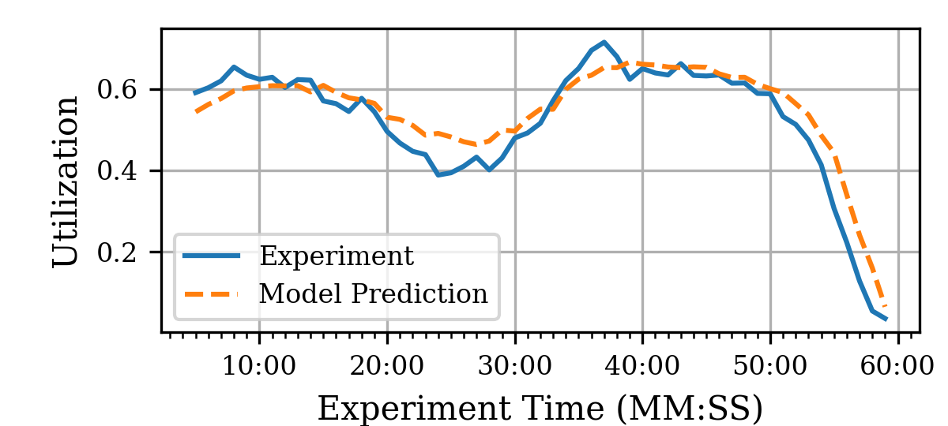
Experimental Results (2)
Notes:
Bars show standard error
Each point is the average of 28 hours of experiment (steady-state) with 10 minutes of warmup

Slide 20
Conclusion

Slide 21
Conclusion
Accurate and tractable analytical performance model
Ability to predict important performance/cost related metrics
Can predict QoS
Can benefit serverless providers
Ability to predict QoS under different loads on deployment time
Can be used in the management to prevent performance degradation
Could be useful to application developers
Predict how their system will perform in the immediate future
Help them optimize their memory configuration to occur minimal cost that satisfies performance requirements throughout their daily request patterns
Can be used in the management systems to warm-up instances to prevent SLA violations

Slide 22
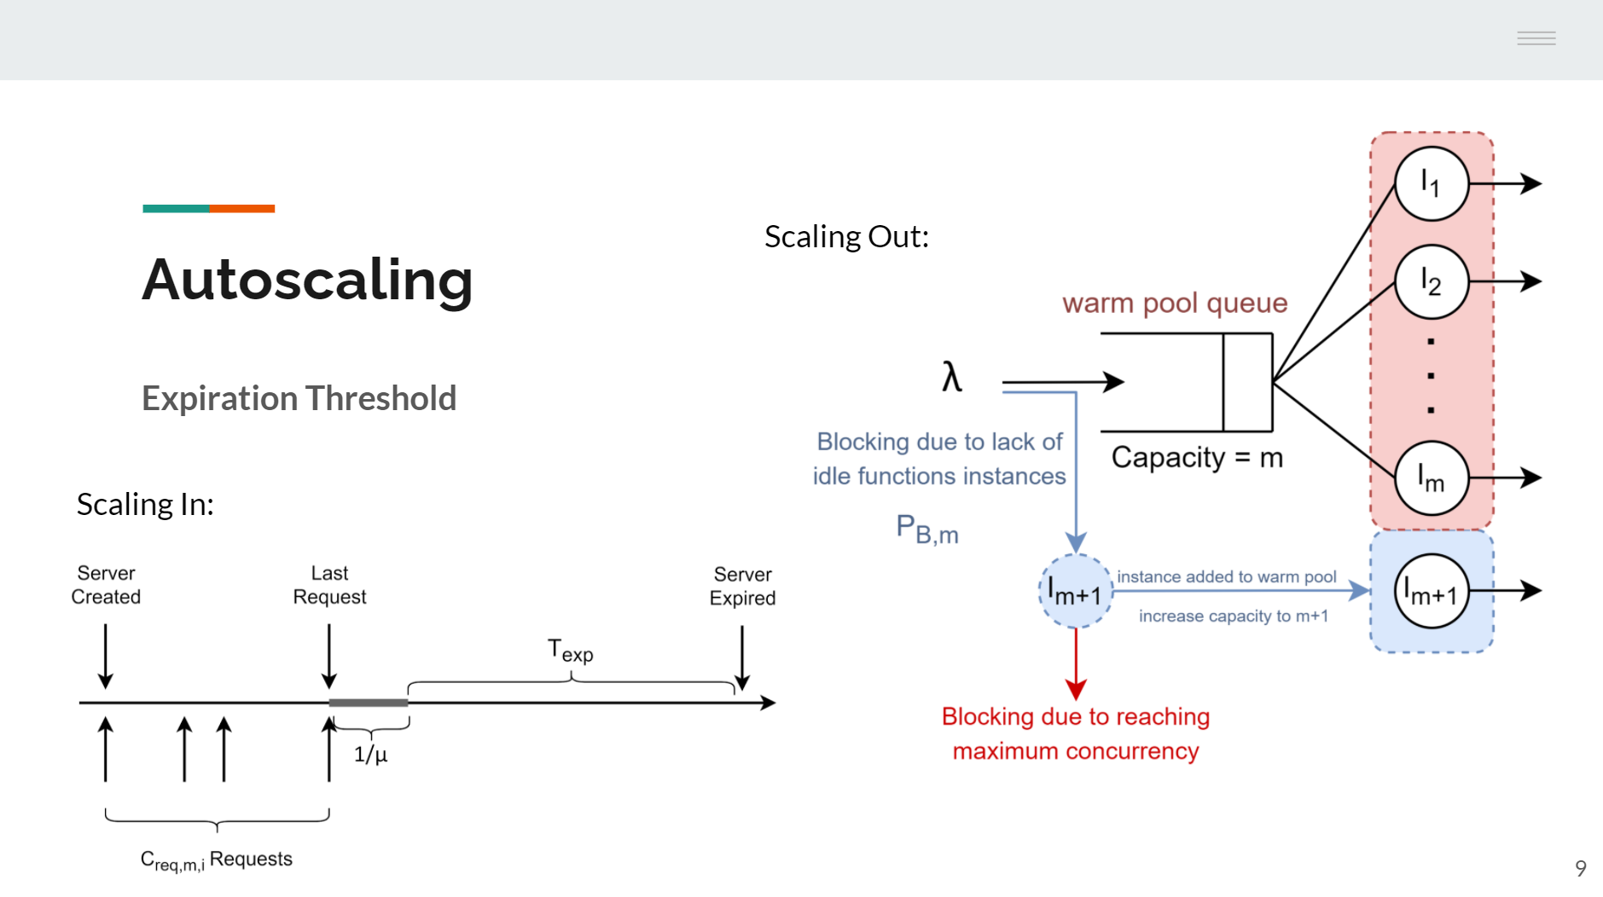
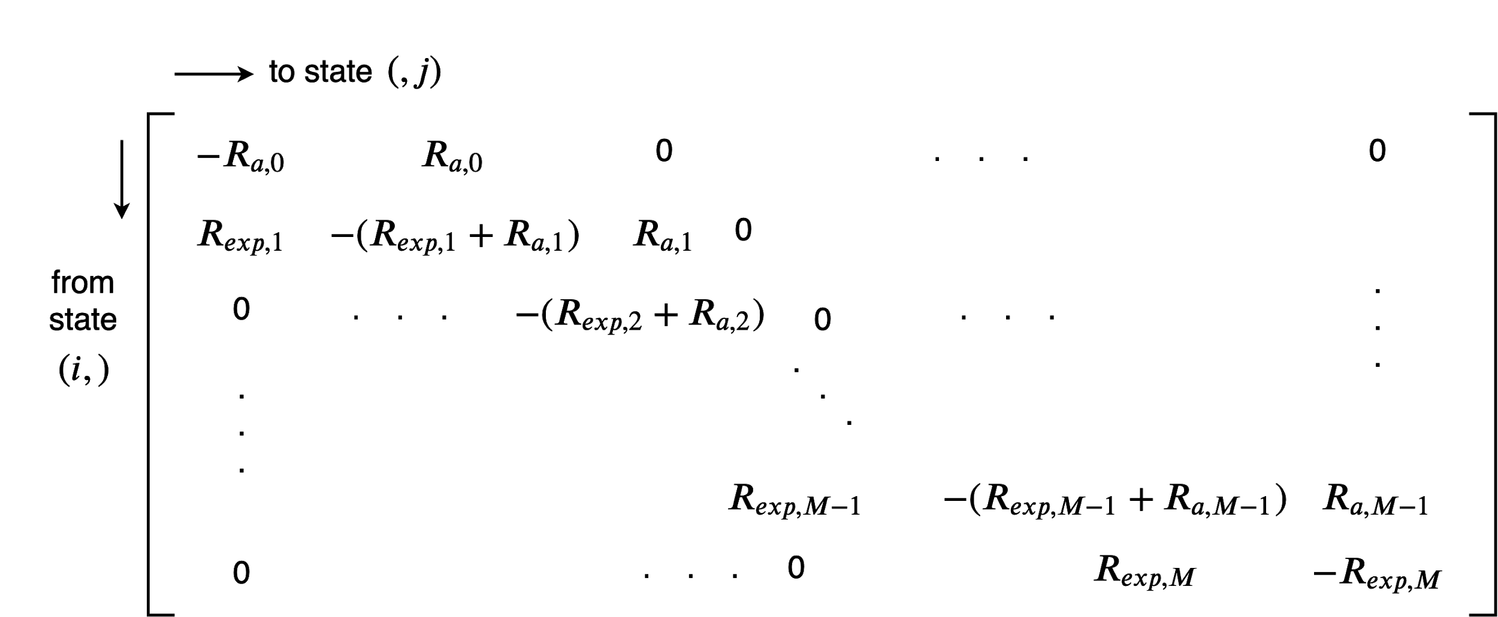
Summary
Website: nima-dev.com
Twitter: @nima_mahmoudi
Notes:
Performance model could benefit both the provider and application developer
We leveraged Markov Chains and M/G/m/m queues to build a performance model for widespread serverless computing platforms
Experimental results show the accuracy of our model for predicting QoS for different configurations
What-if analysis is made possible that could potentially improve QoS in serverless computing platforms

